Slide 1

Topic: Usage and management of left over eatable materials from surroundings
By: Abhilash, Pranav and Ananya

Slide 2
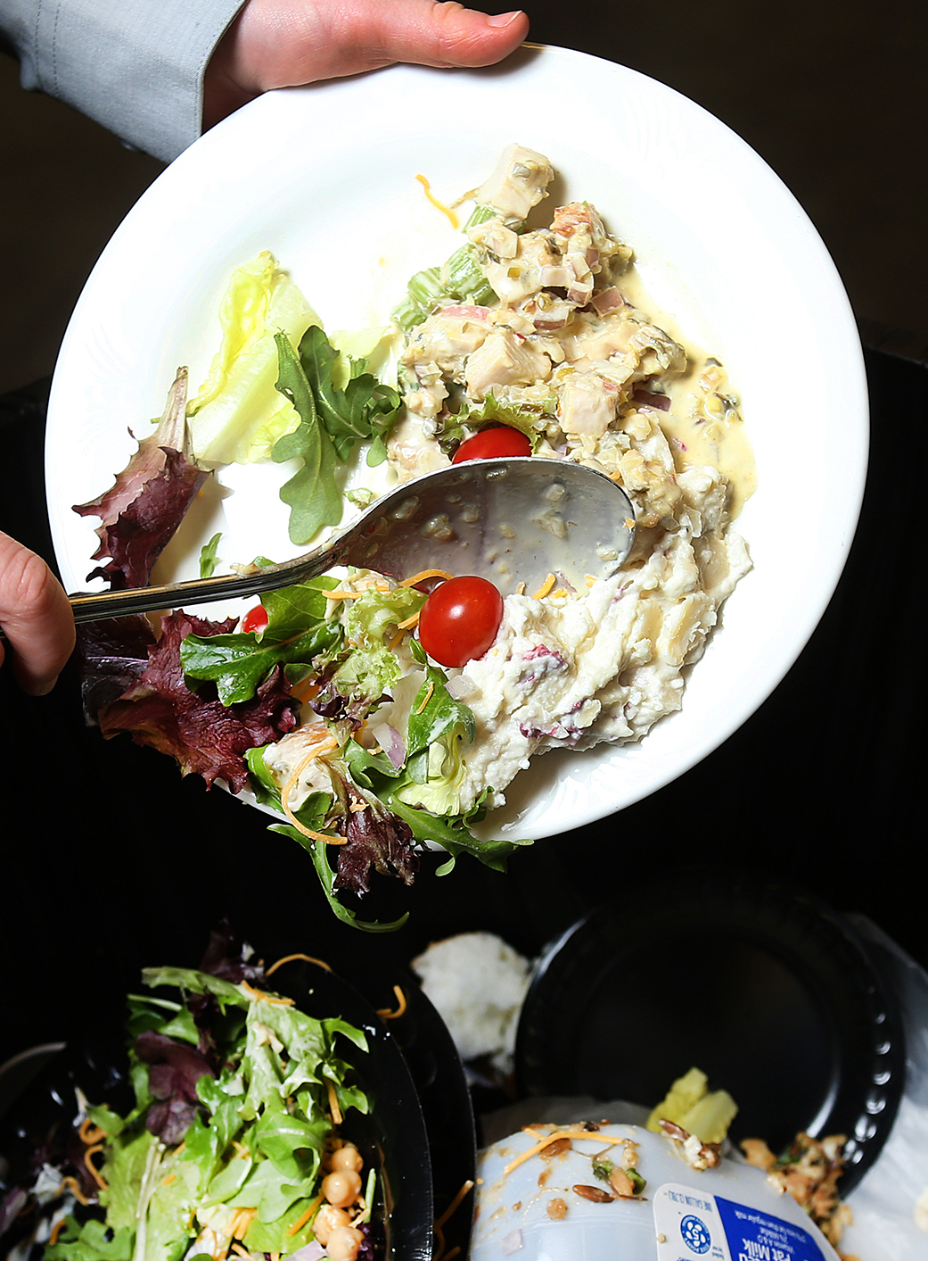
Food waste management in India is becoming a critical problem due to the continuous increase of the Indian population.

Slide 3
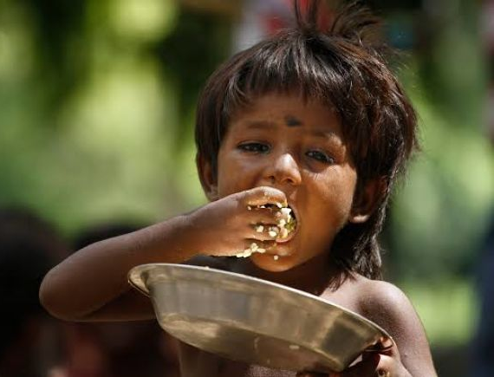
Indians waste the maximum amount of food as much as the whole of the UK consumes – a data point which will not be most indicative of our love of surfeit, because it is of our population.

Slide 4
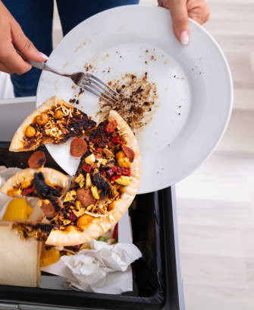
Tossing away uneaten food may appear like meagre damage to the planet when compared to other issues, but the haunting reality is that it is just as harmful.

Slide 5
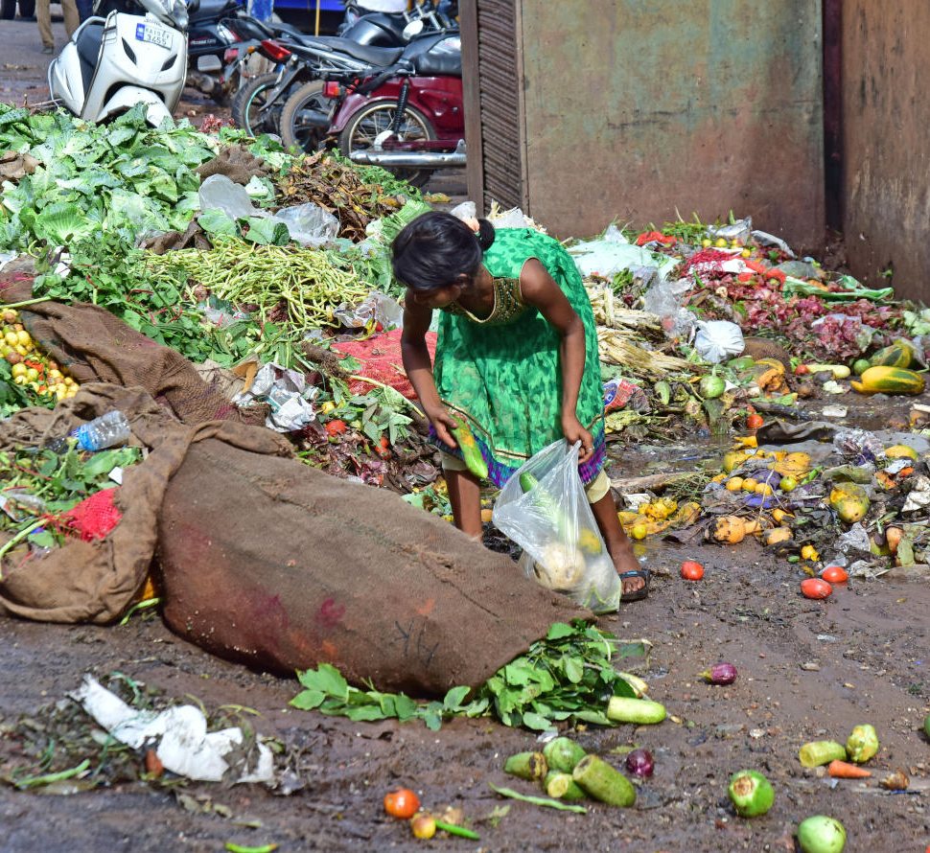
In a world where people are dying from hunger, one-third of all food produced is thrown away every year.

Slide 6
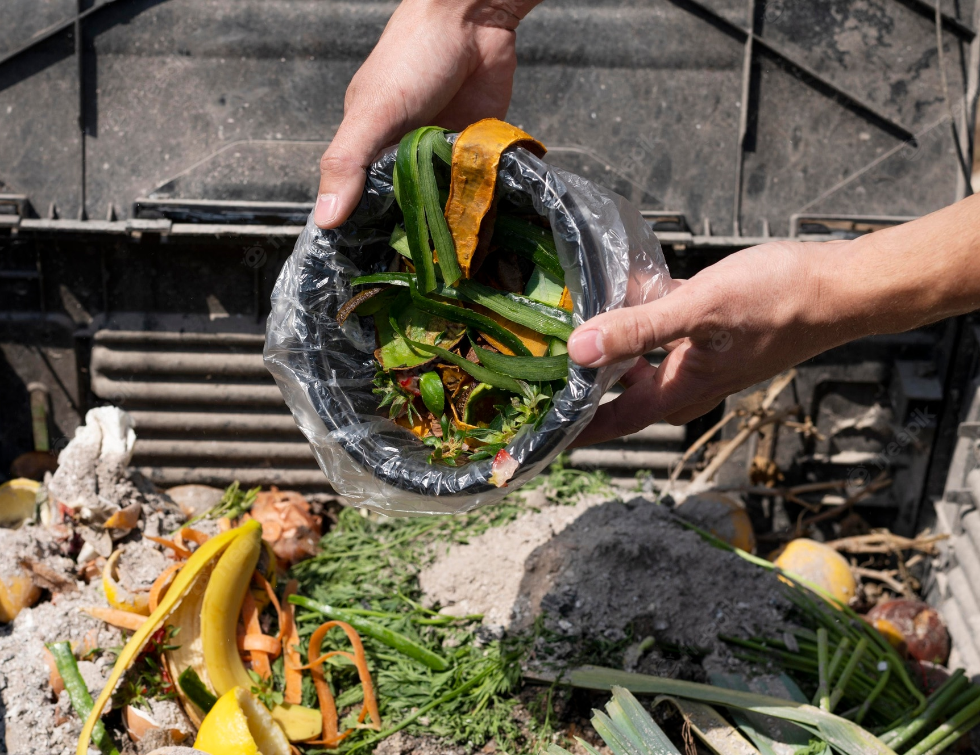
We wanted to do our best in reducing this food wastage problem by creating an application which helps in managing left over eatable materials from the surroundings.

Slide 7

campaigns
Before going to our app we want you to get familiar with few of campaigns in India to prevent wastage of food

Slide 8
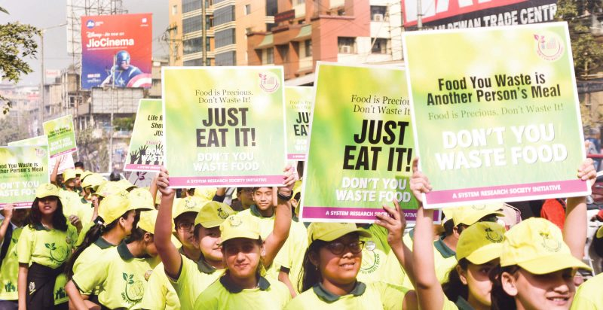
DYWF:- “Don’t You Waste Food” campaign is one of such campaign created to reduce the food wastage in India.

Slide 9
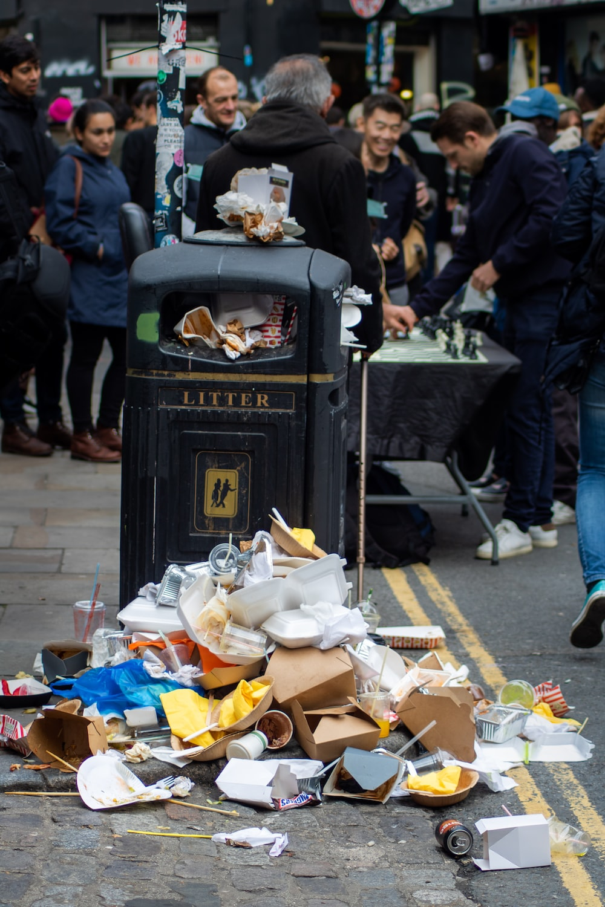
This campaign is a one to one awareness campaign designed to create sensitization around the impending problems, caused due to food waste.

Slide 10
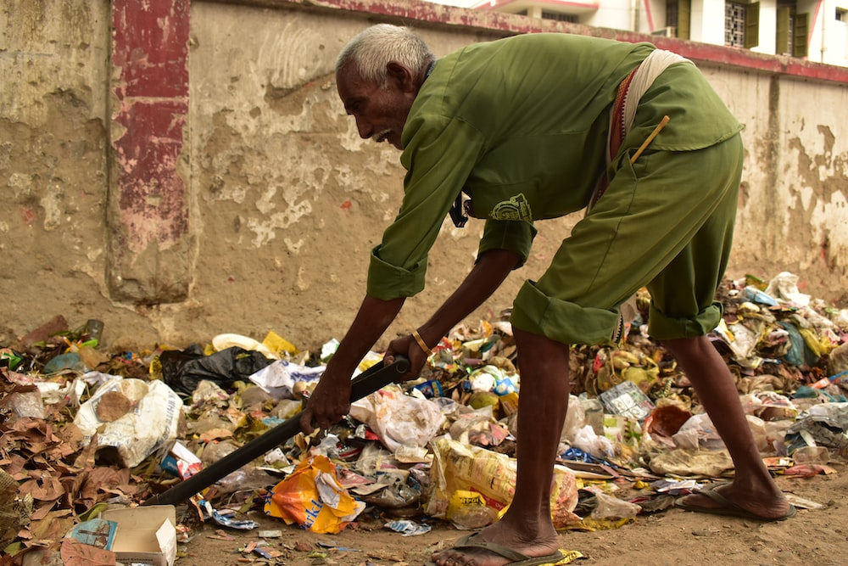
The awareness seminars are believed to be a tool that will yield tangible results in the form of food waste reduction

Slide 11

We look forward to collaborate with the Campaigners such as DYWF, to fulfill the spirit of our app which is to use leftover food mindfully and hunger crisis in the near future.

Slide 12
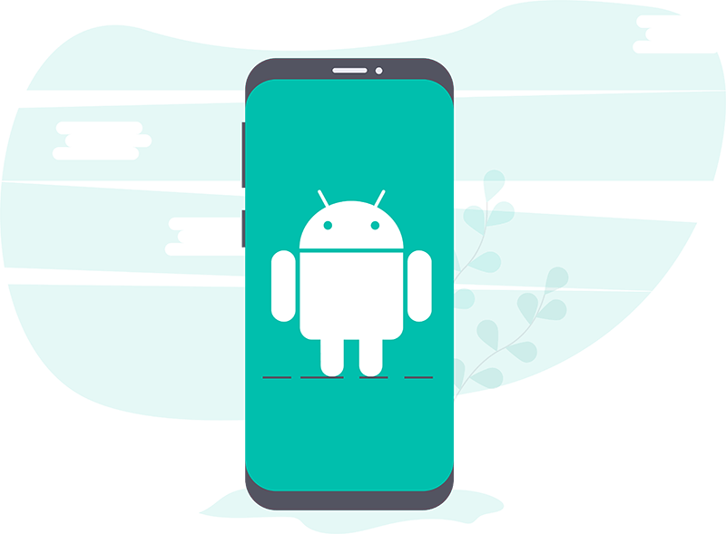
Our Application Meal-It(Prototype)

Slide 13
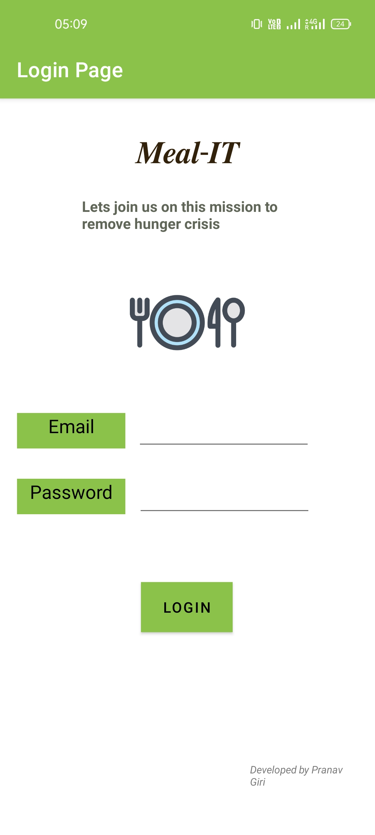
Login Page

Slide 14
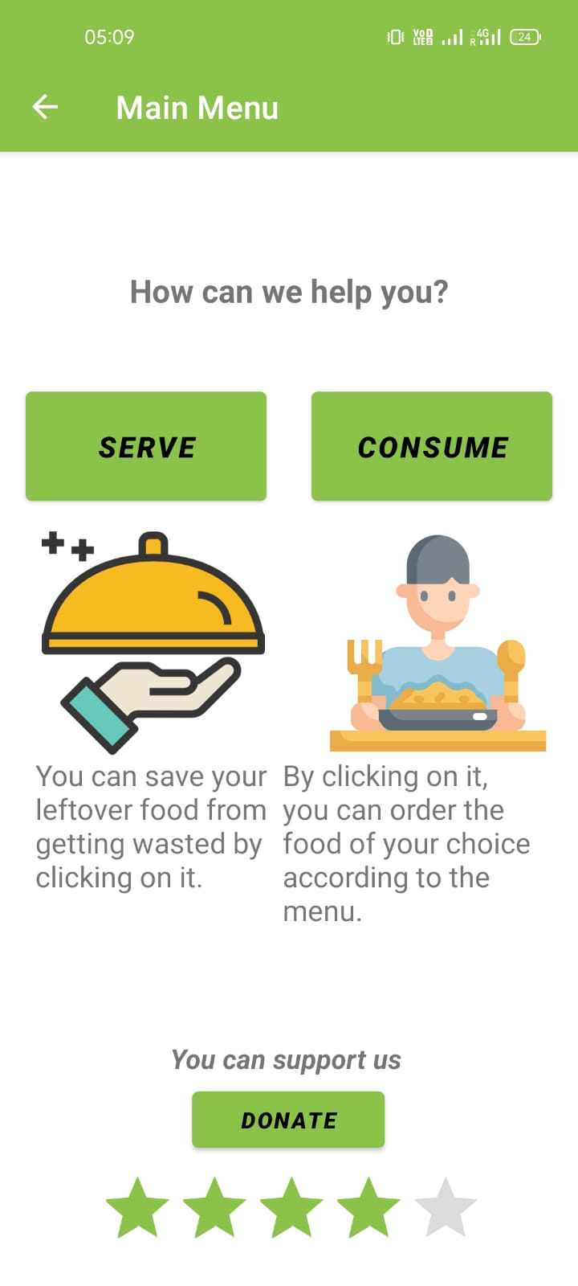
Main Menu
Here You can either serve or Consume the leftover food.

Slide 15
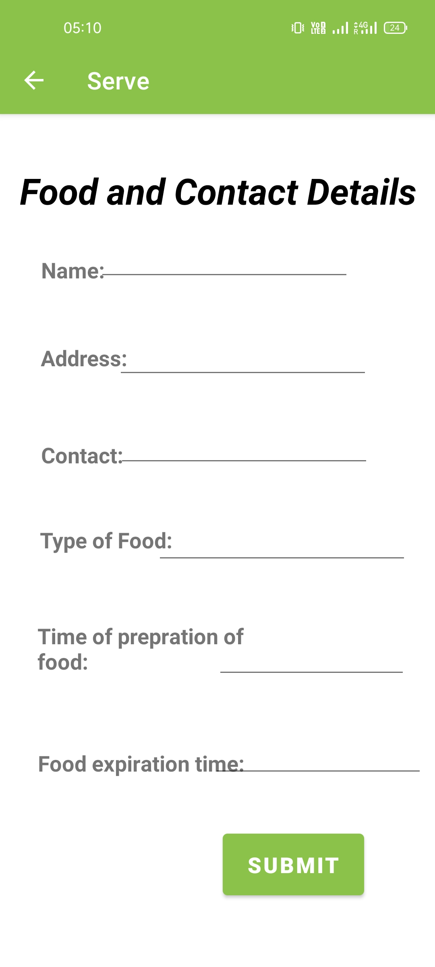
Serving Food
You can send your leftover foods to your nearest “Food Wastage Campaigns” which we commonly call as “HUB”.

Slide 16
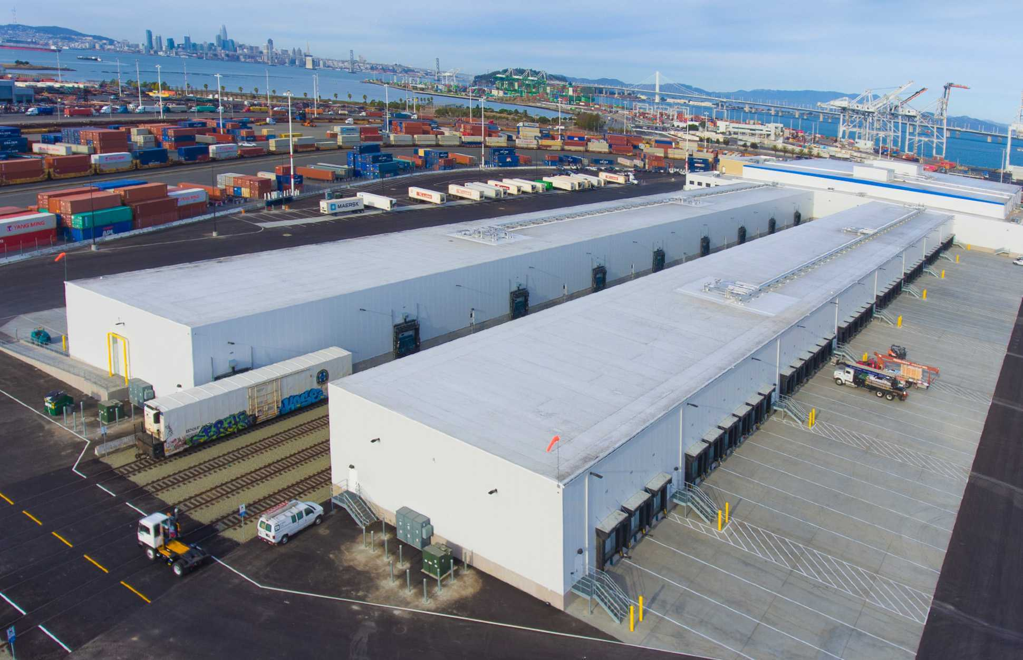
Hub
Hubs are the place where we can store leftover foods from all over the city. It will send the food to those communities of people who can’t afford 3 day meal.

Slide 17
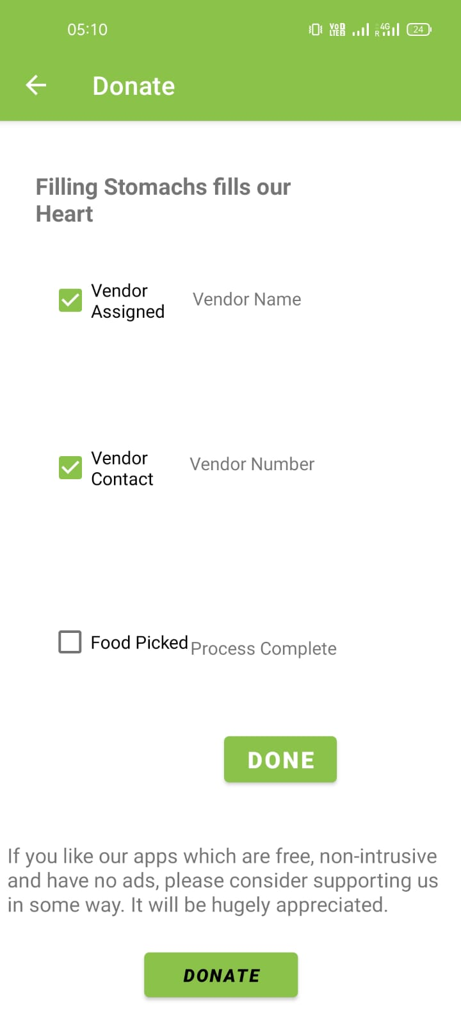
Confirmation
Precise tracking of your food and its care is now our responsibility

Slide 18
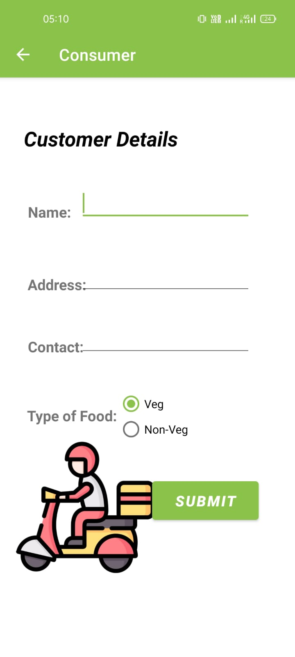
Consumer
As a user of our app you can even get the leftover food for yourself too. We are focusing on minimal wastage of food.
You can even Choose your choice of food

Slide 19
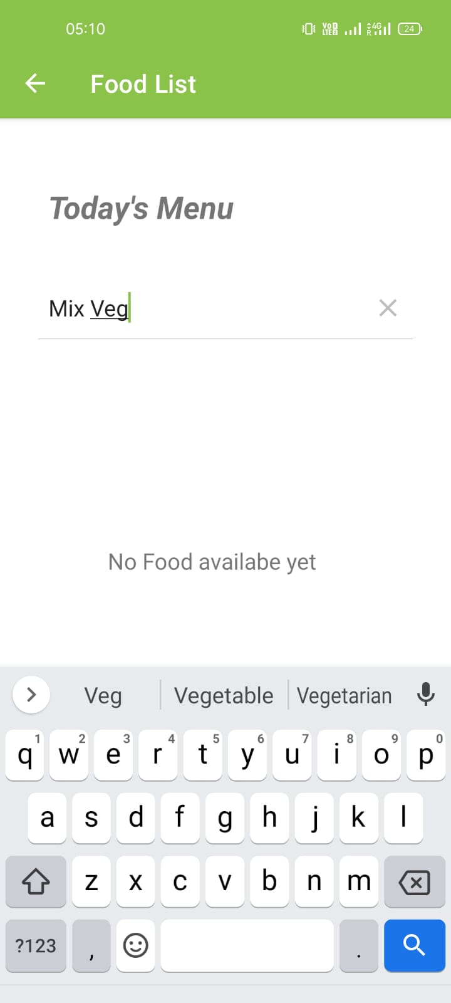
Today’s Menu
For more precise selection of your food from the menu, you can search food of your choice.

Slide 20
Our benefits
You can rate us, and for more support you can donate us.
By clicking on the donate button, it will redirect you to our account details.

Slide 21
Thank you
By: Abhilash, Pranav and Ananya

